Slide 1

Identifying Customer Patterns Influencing Hotel Bookings on
Project Presentation By Elevate Travel Consulting
Group 7B: Tyler Camelot, Ziqi Huang, Yu-Fang Huang, Ilnaz Bagheri, Lasya Reddy Kotha
Notes:
Ilnaz

Slide 2
Problem Statement
Online Global Travel Platform Offers services varying from hotel and flight bookings to car rentals Operates over 70 countries, serving travelers worldwide
Problem Statement
How can Expedia leverage booking behavior insights, like destination distance and promotion usage, to implement personalized marketing strategies that increase customer hotel booking conversions and boost company revenue?
Notes:
Ilnaz

Slide 3

Data Overview
Data Acquisition: Kaggle → Expedia Hotel Booking Behavior Size: 9,917,530 search events 54 variables Selected Variables: Dependent: Booking Boolean (1=booked, 0=did not book) Independent: Search Variables: Length of stay, adults, children, room count, Saturday night, and destination distance Hotel Variables: Hotel price ($), property review score and star rating Other Variables: Promotion Boolean Preprocessing: Removing missing values Random stratified sample of 1 million search events Scaling continuous and count variables
Notes:
Ilnaz

Slide 4
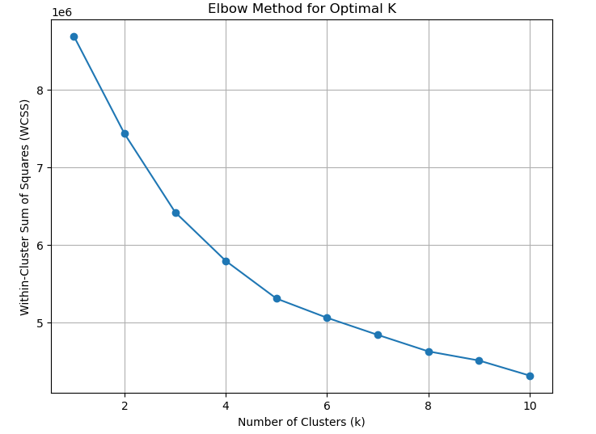
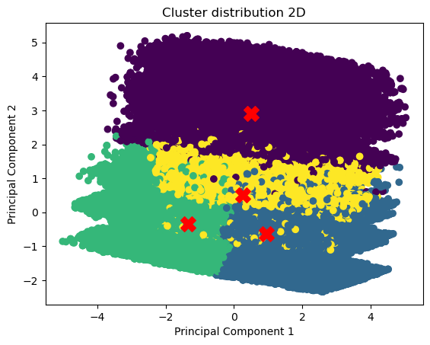
Model/Analysis of Clustering
Clustering (K-Means)
  Identify optimal number of clusters → 4
  Build K-Means model
  Visualize cluster distribution
Cluster Distribution
  Cluster 1 – 9%
  Cluster 2 – 39%
  Cluster 3 – 34%
  Cluster 4 – 19%
Notes:
Peter
Clustering (K-Means)
Identified optimal number of clusters using Elbow Method for data segmentation(where the rate of decrease suddenly slows down, Increasing k beyond this point yields only marginal improvements.)
Built K-Means model to group customers by behavioral similarity
Visualized cluster distribution to interpret key user segments and trends
Clustering:
Found optimal K of 4 through the elbow method and confirmed this assumption by using the Knee Locator python library
Created a K-Means model with four distinct segments each having their own specific attributes
Cluster Distribution: Cluster 1 - 9%, Cluster 2 – 34%, Cluster 3 – 38%, Cluster 4 – 19%

Slide 5
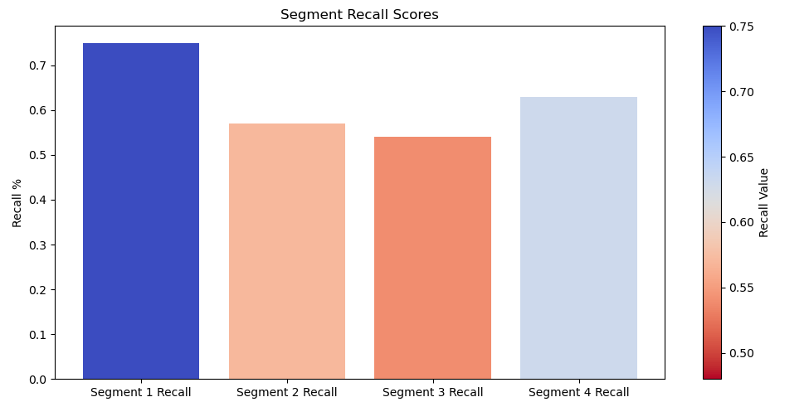
Model/Analysis of Regression
Logistic Regression
  Apply logistic regression
  Evaluate model precision:
    59% ~ 9% better than guessing at random
  Segment Recall:
    Segment 1: 74%
    Segment 2: 57%
    Segment 3: 54%
    Segment 4: 63%
Notes:
Peter
Logistic Regression
Applied logistic regression to predict categorical features outcome(e.g., purchase likelihood)
Evaluated model accuracy and key feature importance for decision insights
Logistic Regression:
We created regression models for each cluster to find the most influential factors (highest weight) that motivate each segment's customers to do reservation on Expedia
Our models were able to have an around 59% prediction accuracy of booking status, which is 9% higher than the even probability of randomly guessing.
More specifically, Cluster 1 had a 74% accuracy. Meaning this model generated a strong understanding of what factors lead people to book with Expedia
Cluster 4 had a 62.5% accuracy. This result means that the model was still better than picking at random and created a general understanding of what factors lead people to book with Expedia
Clusters 2 and 3 had weaker accuracy rates at 54.7% and 57.2% respectively. These models were still better than picking at random, but given their weak understanding of what leads customers to book our focus should lead heavily on clusters 1 and 4.
The reason behind the differences will be uncovered later, but first, Yvvone will take the lead of introducing our detailed findings of each cluster.

Slide 6
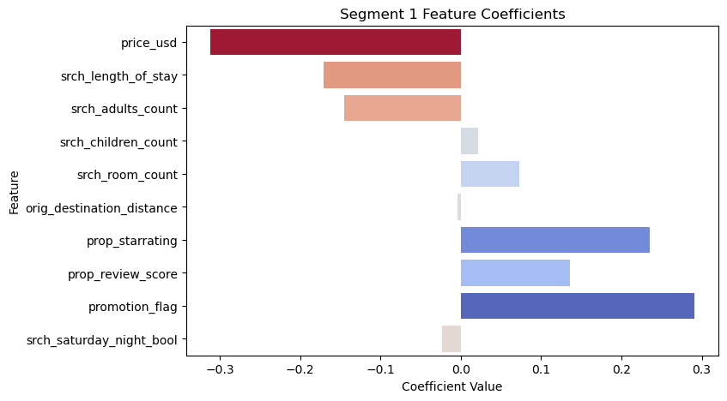
Segment 1 Results/Insights
Solo Nearby Travelers
1. Primarily solo travelers, typically unaccompanied by additional
adults → -0.15 srch_adult_count
2. Prefer short distance trips, indicating a tendency to stay close to home → -0.004 orig_destination_distance
𝑏𝑜𝑜𝑘 = 0.02 + (−0.31*𝑝𝑟𝑖𝑐𝑒_𝑢𝑠𝑑) + (−0.17*𝑠𝑟𝑐ℎ_ 𝑙𝑒𝑛𝑔𝑡ℎ_ 𝑜𝑓_ 𝑠𝑡𝑎𝑦) +
(−0.15*𝑠𝑟𝑐ℎ_ 𝑎𝑑𝑢𝑙𝑡𝑠_ 𝑐𝑜𝑢𝑛𝑡) + (0.02*𝑠𝑟𝑐ℎ_ 𝑐ℎ𝑖𝑙𝑑𝑟𝑒𝑛_ 𝑐𝑜𝑢𝑛𝑡) +
(0.07*𝑠𝑟𝑐ℎ_ 𝑟𝑜𝑜𝑚_𝑜𝑢𝑛𝑡) + (-0.004*𝑜𝑟𝑖𝑔_ 𝑑𝑒𝑠𝑡𝑖𝑛𝑎𝑡𝑖𝑜𝑛_ 𝑑𝑖𝑠𝑡𝑎𝑛𝑐𝑒) +
(0.24* 𝑝𝑟𝑜𝑝_ 𝑠𝑡𝑟𝑟𝑎𝑡𝑖𝑛𝑔) + (0.14* 𝑝𝑟𝑜𝑝_ 𝑟𝑒𝑣𝑖𝑒𝑤_ 𝑠𝑐𝑜𝑟𝑒) +
(0.29*𝑝𝑟𝑜𝑚𝑜𝑡𝑖𝑜𝑛_ 𝑓𝑙𝑎𝑔) + (−0.02*𝑠𝑟𝑐ℎ_ 𝑠𝑎𝑡𝑢𝑟𝑑𝑎𝑦_ 𝑛𝑖𝑔ℎ𝑡_ 𝑏𝑜𝑜𝑙)
Notes:
Yvonne
For Cluster 1, the strongest driver is srch_adults_count. Lower adult counts (1–2) push the prediction more towards booking → this aligns with more solo / couple travel.
prop_starrating is also showing a positive lift. When we see the pink dots (higher stars) shifted slightly to the right, it tells us that for this group they are more likely to convert on higher-star hotels.
Overall, this segmentation is characterized mainly by solo travel behavior and preference for short-distance destinations. The travelers tend to stay close to home and typically travel independently.
Lower adult counts show strong influence → Tend to be 1-2 people trips (Solo travelers)
Destination distance has little influence → They do not travel far
Higher star rating have positive impact → More likely to book when the hotel has higher stars.

Slide 7
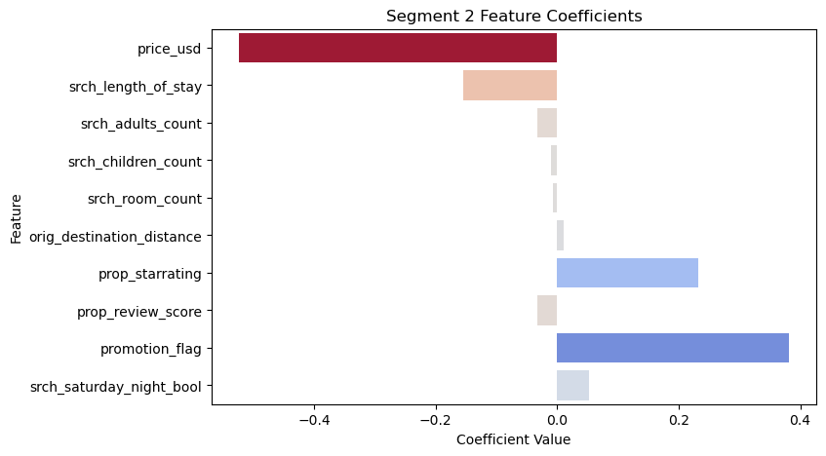
Segment 2 Results/Insights
Price-Sensitive Budget Travelers
1. Most price sensitive segment
→ -0.52 price_usd
2. Least concerned about the review score → -0.03 prop_review_score
𝑏𝑜𝑜𝑘 = 0.02 + (−0.52*𝑝𝑟𝑖𝑐𝑒_𝑢𝑠𝑑) + (−0.16*𝑠𝑟𝑐ℎ_ 𝑙𝑒𝑛𝑔𝑡ℎ_ 𝑜𝑓_ 𝑠𝑡𝑎𝑦) +
(−0.03*𝑠𝑟𝑐ℎ _ 𝑎𝑑𝑢𝑙𝑡𝑠_ 𝑐𝑜𝑢𝑛𝑡) + (−0.01*𝑠𝑟𝑐ℎ_ 𝑐ℎ𝑖𝑙𝑑𝑟𝑒𝑛_ 𝑐𝑜𝑢𝑛𝑡) +
(−0.01*𝑠𝑟𝑐ℎ_ 𝑟𝑜𝑜𝑚_ 𝑐𝑜𝑢𝑛𝑡) +
(0.01*𝑜𝑟𝑖𝑔 _ 𝑑𝑒𝑠𝑡𝑖𝑛𝑎𝑡𝑖𝑜𝑛_𝑑𝑖𝑠𝑡𝑎𝑛𝑐𝑒) + (0.23*𝑝𝑟𝑜𝑝_ 𝑠𝑡𝑎𝑟𝑟𝑎𝑡𝑖𝑛𝑔) +
(−0.03*𝑝𝑟𝑜𝑝_ 𝑟𝑒𝑣𝑖𝑒𝑤_ 𝑠𝑐𝑜𝑟𝑒) + ( 0.38*𝑝𝑟𝑜𝑚𝑜𝑡𝑖𝑜𝑛_ 𝑓𝑙𝑎𝑔) +
(0.05*𝑠𝑟𝑐ℎ_𝑠𝑎𝑡𝑢𝑟𝑑𝑎𝑦_ 𝑛𝑖𝑔ℎ𝑡_ 𝑏𝑜𝑜𝑙)
Notes:
Yvonne
For the second cluster, the strongest driver is price. It has a large negative coefficient which indicate that travelers in this segment are highly price-sensitive when booking a hotel.
Travelers are least concerned about the review score, meaning that they do not place much weight on quality ratings when making their booking decisions.
Overall, this segmentation is characterized mainly by strong price sensitivity and minimal reliance on quality signals.

Slide 8
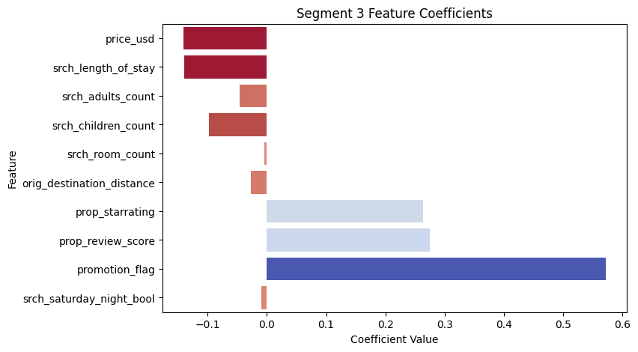
Segment 3 Results/Insights
Adult-Only Promotion and Quality Seeking Travelers
1.Traveling without
children → -0.1 srch_children_count
2. Quality-driven focus, looking for hotels with high star ratings and strong
reviews → 0.28 prop_review_score
3. Less price sensitive, weak influence on booking decision making → -0.14 price_usd
4. Highly responsive to
promotions → 0.57 promotion_flag
𝑏𝑜𝑜𝑘 = 0.01 + (−0.14*𝑝𝑟𝑖𝑐𝑒_ 𝑢𝑠𝑑) + (−0.14*𝑠𝑟𝑐ℎ_ 𝑙𝑒𝑛𝑔𝑡ℎ_ 𝑜𝑓_ 𝑠𝑡𝑎𝑦) +
(−0.05*𝑠𝑟𝑐ℎ_ 𝑎𝑑𝑢𝑙𝑡𝑠_𝑐𝑜𝑢𝑛𝑡) + (−0.1*𝑠𝑟𝑐ℎ_ 𝑐ℎ𝑖𝑙𝑑𝑟𝑒𝑛_ 𝑐𝑜𝑢𝑛𝑡) +
(−0.0*𝑠𝑟𝑐ℎ_ 𝑟𝑜𝑜𝑚_ 𝑐𝑜𝑢𝑛𝑡) +
(−0.03*𝑜𝑟𝑖𝑔_ 𝑑𝑒𝑠𝑡𝑖𝑛𝑎𝑡𝑖𝑜𝑛_ 𝑑𝑖𝑠𝑡𝑎𝑛𝑐𝑒) + (0.26*𝑝𝑟𝑜𝑝_ 𝑠𝑡𝑎𝑟𝑟𝑎𝑡𝑖𝑛𝑔)
+ (0.28*𝑝𝑟𝑜𝑝_𝑟𝑒𝑣𝑖𝑒𝑤_𝑠𝑐𝑜𝑟𝑒) + (0.57*𝑝𝑟𝑜𝑚𝑜𝑡𝑖𝑜𝑛_ 𝑓𝑙𝑎𝑔) +
(−0.01*𝑠𝑟𝑐ℎ_ 𝑠𝑎𝑡𝑢𝑟𝑑𝑎𝑦_ 𝑛𝑖𝑔ℎ𝑡_ 𝑏𝑜𝑜𝑙)
Notes:
Lasya

Slide 9
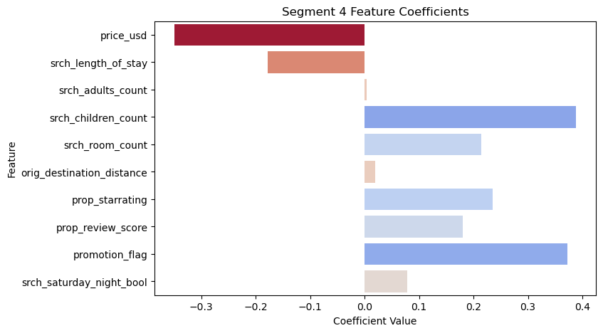
Segment 4 Results/Insights
Large Group/Family Travelers
1. Highest family orientation → 0.40 srch_children_count
2. Highest multi-room bookings
→ 0.21 srch_room_count
3. Prefer shorter trips → 0.08 srch_saturday_night_bool
𝑏𝑜𝑜𝑘 = −0.68 + (−0.35*𝑝𝑟𝑖𝑐𝑒_ 𝑢𝑠𝑑) + (−0.18*𝑠𝑟𝑐ℎ_ 𝑙𝑒𝑛𝑔𝑡ℎ_ 𝑜𝑓_ 𝑠𝑡𝑎𝑦) +
(0.004*𝑠𝑟𝑐ℎ_ 𝑎𝑑𝑢𝑙𝑡𝑠_ 𝑐𝑜𝑢𝑛𝑡) + (0.40*𝑠𝑟𝑐ℎ_ 𝑐ℎ𝑖𝑙𝑑𝑟𝑒𝑛_ 𝑐𝑜𝑢𝑛𝑡) +
(0.21*𝑠𝑟𝑐ℎ_ 𝑟𝑜𝑜𝑚_ 𝑐𝑜𝑢𝑛𝑡) + (0.02*𝑜𝑟𝑖𝑔_𝑑𝑒𝑠𝑡𝑖𝑛𝑎𝑡𝑖𝑜𝑛_ 𝑑𝑖𝑠𝑡𝑎𝑛𝑐𝑒)
+ (0.24*𝑝𝑟𝑜𝑝_ 𝑠𝑡𝑎𝑟𝑟𝑎𝑡𝑖𝑛𝑔) + (0.18*𝑝𝑟𝑜𝑝_ 𝑟𝑒𝑣𝑖𝑒𝑤_ 𝑠𝑐𝑜𝑟𝑒) +
(0.37*𝑝𝑟𝑜𝑚𝑜𝑡𝑖𝑜𝑛_ 𝑓𝑙𝑎𝑔) + (0.08*𝑠𝑟𝑐ℎ _ 𝑠𝑎𝑡𝑢𝑟𝑑𝑎𝑦_ 𝑛𝑖𝑔ℎ𝑡_ 𝑏𝑜𝑜𝑙)
Notes:
Lasya

Slide 10
Targeting Strategies
Segment 1 Solo Nearby Travelers | Segment 2 Price-Sensitive Budget Travelers | Segment 3 Adult-Only Promotion and Quality Seeking Travelers | Segment 4 Large Group/Family Travelers
Local Hotels | Affordable Hotels | Luxury Hotels | Family Friendly Hotels
Solo Travel Opportunities | Budget Friendly Deals | Adult-Centric Experiences | Group Activity Packages
Notes:
Tyler
Solo Travel Opportunities:
Single-Traveler Rates: “No single-supplement” pricing for 1-person stays.
Loyalty Instant Rewards: “Book now, earn free late checkout on your next solo trip.”
Curated Single Traveler Itineraries
Adult-Centric Experiences:
Couples Getaway Packages: Include spa credits, champagne, and private dining.
Wellness Retreats: Market yoga, meditation, or fitness weekends for rejuvenation.
Cultural Immersion Offers: Pair stays with local winery tours, art exhibits, or concerts.
Weekend Escapes: “Two-Night Escape” bundles for spontaneous short trips.
Budget Deals:
Room + Breakfast Bundle
Stay 2 nights, get the 3rd free
Advance-booking savings: “Book 30 days early, save 25%.”
Group Activity Packages:
All-Inclusive Family Bundles: “Meals, rooms, and fun—no planning needed.”
Family Adventure Packages: Combine stay + tickets to local attractions (theme parks, zoos, museums).
Multi-Room Discounts: “Book 2+ rooms and save 15%.”
Kids-Stay-Free Offers: “Kids stay and eat free with every adult booking.”

Slide 11
Implications
Implement Individualized Booking Opportunities
Increase platform engagement and trip-planning amongst independent travelers
Interest and retention should increase amongst the value-focused customers
Increase average order values amongst luxury-leaning audience
Expect an increase in cross selling profits
Advertise Personalized Hotel Listings
Build stronger relationships with local hotel brands
Increase sales for less frequently booked hotels
Higher conversion rate for expensive and highly profitable hotels
Increase multi-room sales and family-friendly bookings
Segment 1
Segment 2
Segment 3
Segment 4
Notes:
Tyler
Implement Individualized Booking Opportunities
Segment 1: Solo Travel Opportunities – Late checkout benefits and curated itineraries should increase platform engagement and trip-planning amongst independent travelers
Segment 2: Adult-Centric Experiences – We expect advertising luxury weekend escapes, couple's getaway packages, wellness retreats and more will increase average order values amongst the luxury-leaning audience.
Segment 3: Budget Friendly Deals – By offering advanced booking benefits and bundles we believe interest and retention should increase amongst the value-focused customers
Segment 4: Group Activity Packages – By encouraging all-inclusive family bundles and adventure packages we expect that cross-selling profit should increase.
Advertise Personalized Hotel Listings
Segment 1: Local Hotels – By promoting local hotels we expect this groups booking tendencies to increase and to build stronger business to business relationships with local hotel brands.
Segment 2: Luxury Hotels – Investing in luxury hotel promotions should lead to a higher conversion rate for expensive, and highly profitable hotels
Segment 3: Affordable Hotels – Advertising affordable opportunities will give this target audience more options for vacations and increase sales for less frequently booked hotels
Segment 4: Family Friendly Hotels – With catered promotions for multi-room deals, we expect an increase in profitability for larger group vacations with children to resorts that will cater to their needs.

Slide 12
Thank You
Notes:
From Elevate Travel Consulting, we thank you for taking the time to listen to our pitch on how Expedia can increase booking frequency and subsequently profit margins. By implementing these marketing strategies we expect positive outcomes for both the company and customers alike.

